Slide 1
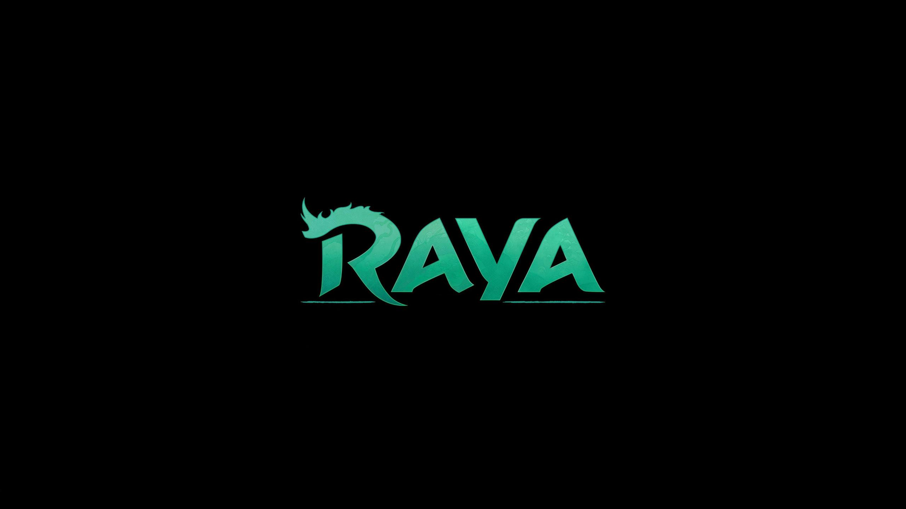
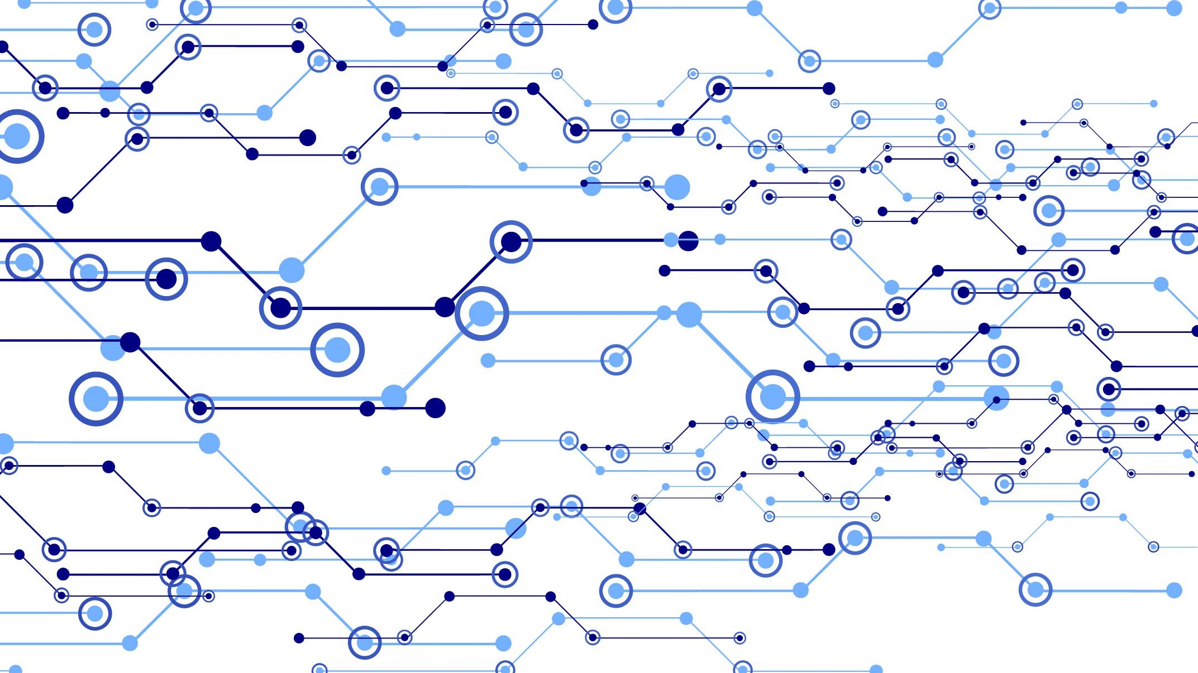

Slide 2
RAYA
Tittle of the Project:-
Hello Ma’am! Today me and my team members would like to present you our project on the topic of “GAME” development which is based on a animated movie name “RAYA and the LAST DRAGON”.
We are trying to develop a Open-World game with a different perspective and objective to make the players feel loosen up in the game with it’s immersive soundtracks and smooth 3d graphics.
We’re developing a game where there are no combat scenes, no aggressive abilities, no quests which makes the players frustrated at some point. So we come up with a idea that There is only roaming in the land of “KUMANTRA” to discover the various location and explore this huge world with their own free will.
Now let’s move to the next slide
where we’ll learn more about our project:-

Slide 3
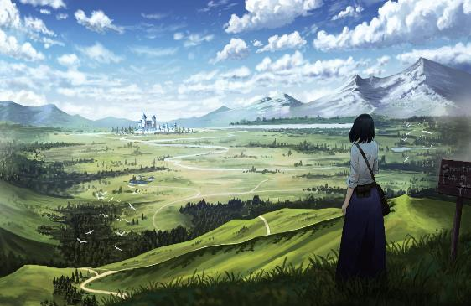
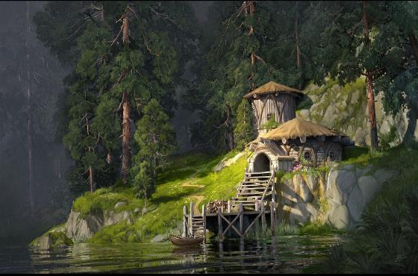
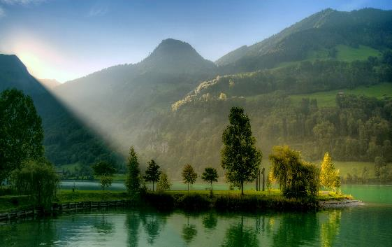
Development Process of RAYA
GRAPHICS :- We’re trying to develop “RAYA” with the help of some 3d stylized, some low-poly and some of anime style graphics.
MAP BUILD:- This is a open-world game so we’re focusing more on environment design and soundtracks. Because the environment graphic is the key element of a open-world game’s beauty along with the sounds mixtures.
You can see some of the reference pictures regarding the environment graphic process of the game which is shown in the right side

Slide 4
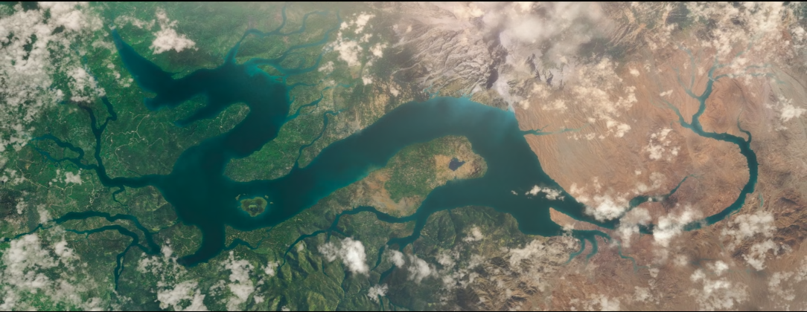
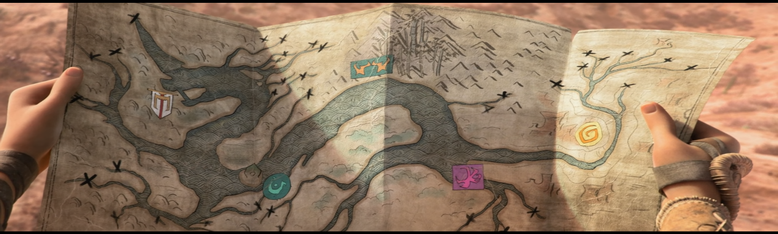
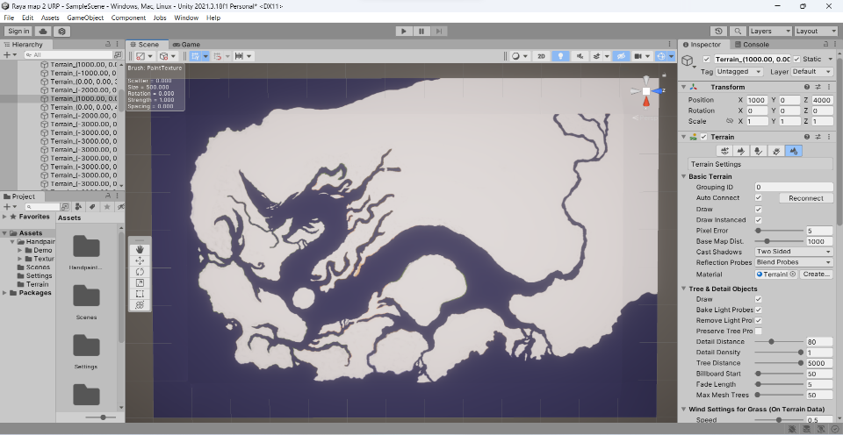
Development Process of RAYA
MAP SIZE AND SAMPLE:-
Our map size is 1km^{2/tiles}
Per Tiles info:-
Width:- 1000m
Length:- 1000m
Height:- 150m
Base Resolution:- 1024x1024

Slide 5
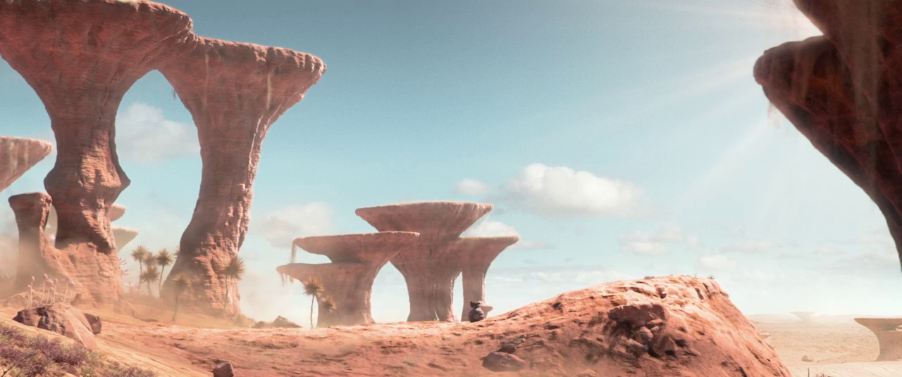
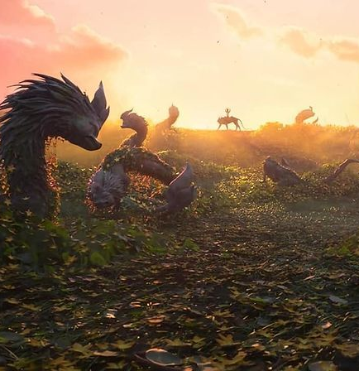
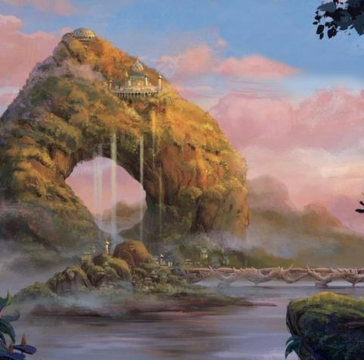
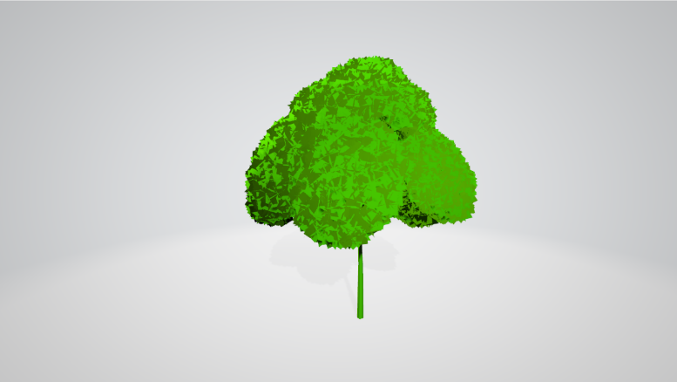
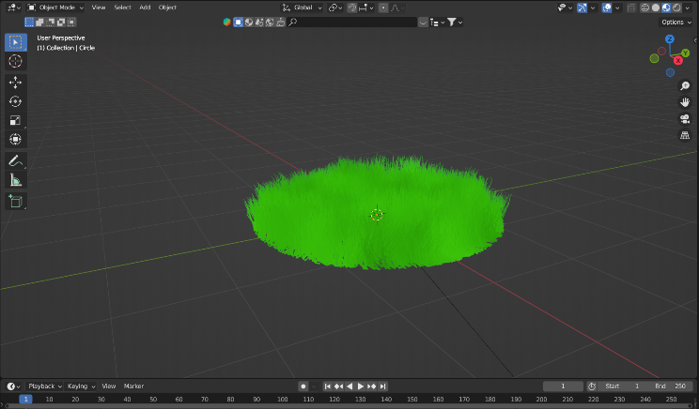
Development Process of RAYA
WORLD BUILDING :- Structures, materials, houses, buildings, vegetations this are the crucial element for the environment build.
You can see some of the pictures regarding the concepts as well as creation process for the in-game assets which is shown in the left side

Slide 6

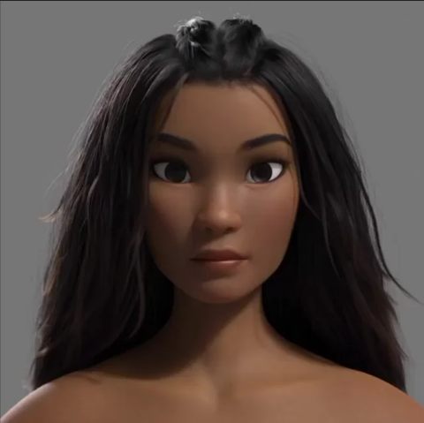
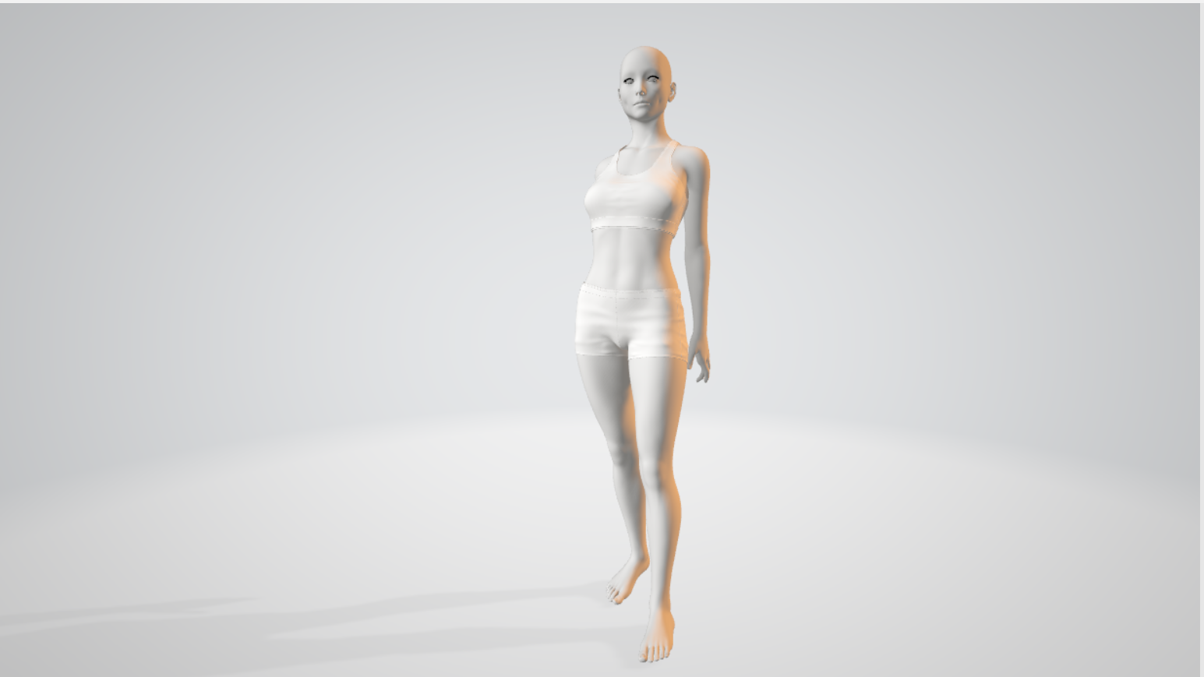
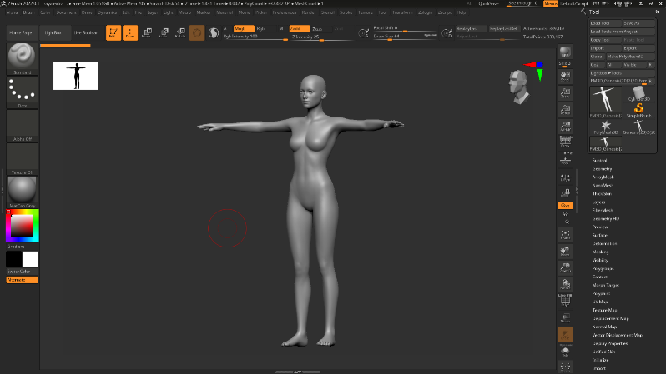
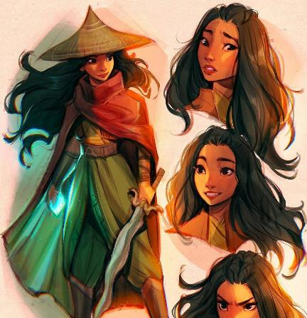
Development Process of RAYA
CHARACTERs :- Till now we’re only trying to develop only the main characters and some of the A.I characters.
Some references and the 3d model which we created to use it in RAYA are shown in the right side

Slide 7
Development Process of RAYA
SOFTWARE & ENGINE:-
We’re using UNITY game engine to develop our game. As well as some editing software and coding software like Photoshop, Visual Studio, Blender, Z-brush, DAZ studio, substance 3D etc.
TOOLS & ASSETS:-
We’re using different types of Tools & assets to create the necessary materials and textures for our game structures. E.g. camera controller, navmesh, terrain textures, material textures and much more.

Slide 8
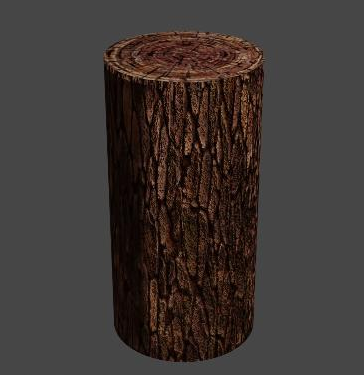
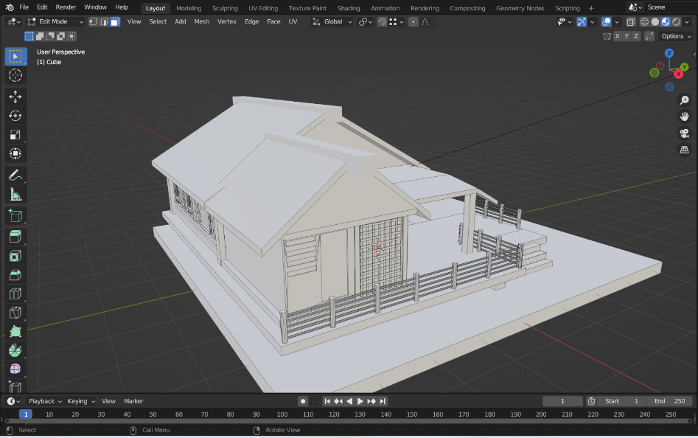

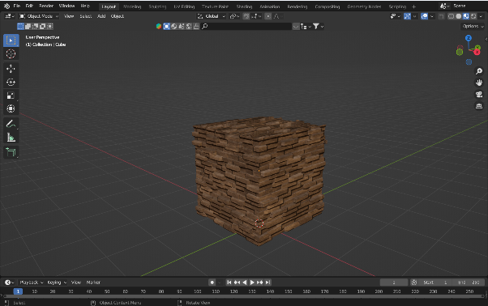
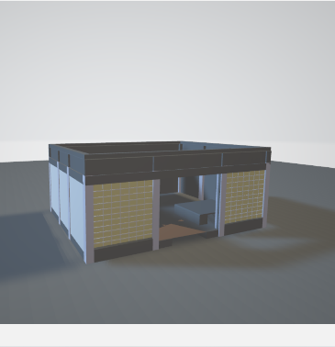
Development Process of RAYA
In the last but not the least let us present some of our works that is done by till now…

Slide 9
THANK YOU!
Feel free to ask questions related to the project, We’ll try our best to give the best answers.

